Slide 1
Fraudulent Claim Detection Case Study
Presented by:
Saidhulu Nalla
Shweta Rathod

Slide 2
Problem Statement
Manual claim verification is time-consuming and inefficient.
Financial losses due to undetected fraudulent claims.
Need for data-driven fraud classification model.

Slide 3
Business Objective
Classify claims as fraudulent or legitimate.
Predict fraud early using customer and incident features.
Improve operational efficiency and reduce losses.

Slide 4
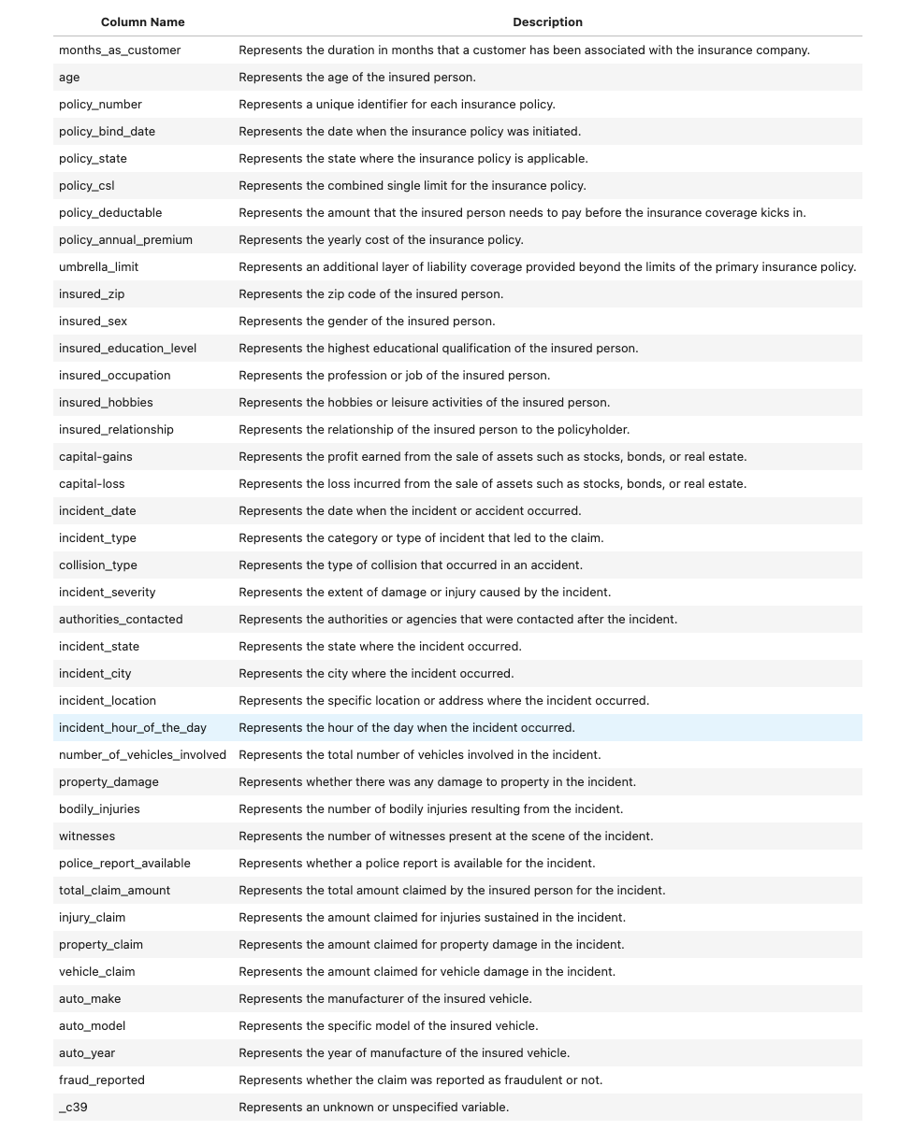
Data Dictionary

Slide 5
Data Cleaning
Insurance claims dataset (1000 rows × 40 columns).
Handling Missing Values
authorities_contacted: Corrected "None" interpreted as null; replaced with 'NA’.
_c39: Column entirely null – dropped.
Redundant Column & Row Cleanup
Removed columns with high uniqueness (e.g., policy_number, incident_location).
Dropped raw date columns post feature derivation.
Invalid/Illogical values – none found.
Data Type Fixes
Converted 'policy_bind_date' and 'incident_date' to datetime format.
Ensured consistency across data types for modeling.

Slide 6
Train-Validation Split
Dataset split into 70% training and 30% validation.
Ensures evaluation of model performance on unseen data.
Stratified sampling used to preserve fraud class balance.
Prevents overfitting and provides fair performance estimation.

Slide 7
EDA on Training Data

Slide 8
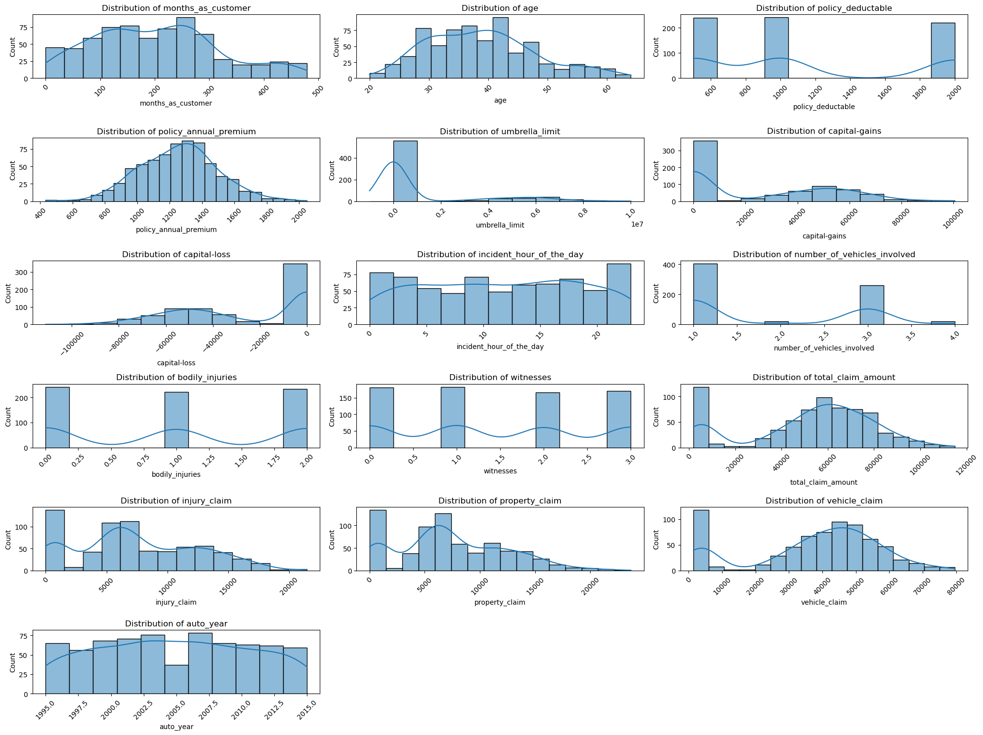
Univariate Analysis

Slide 9
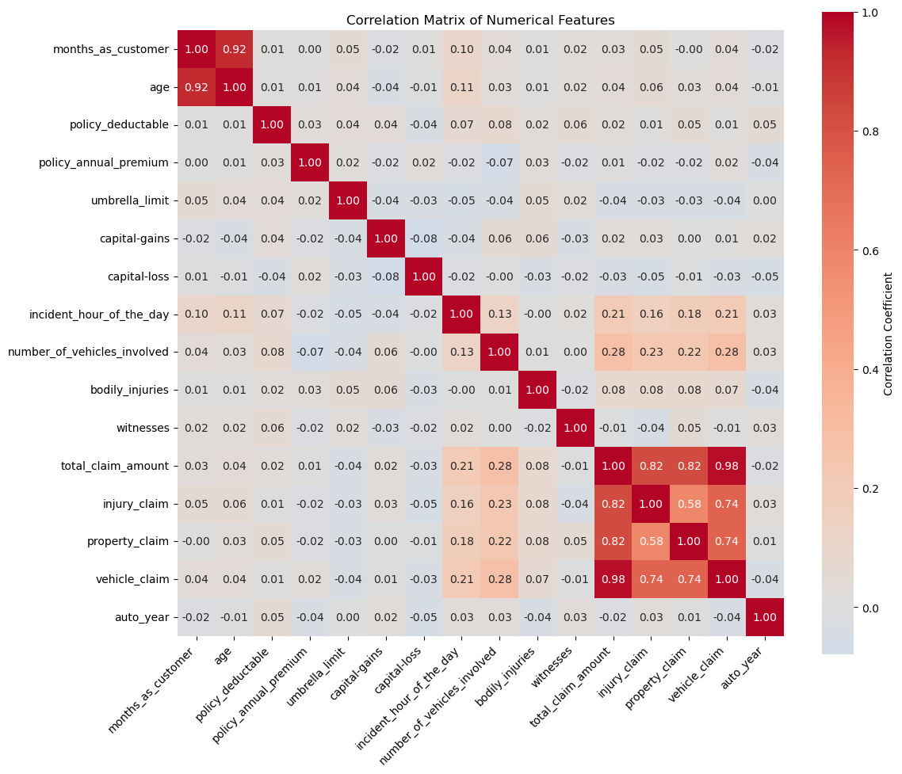
Correlation Analysis

Slide 10
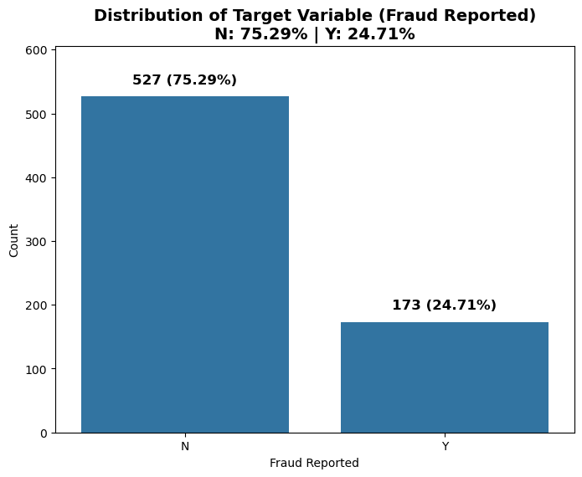
Class Balance

Slide 11
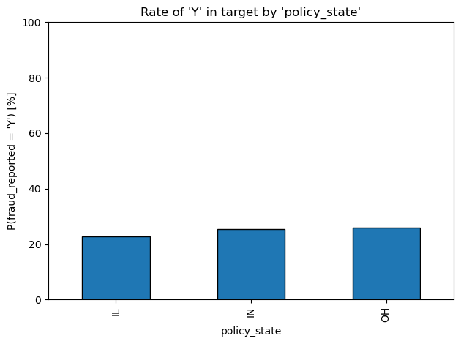
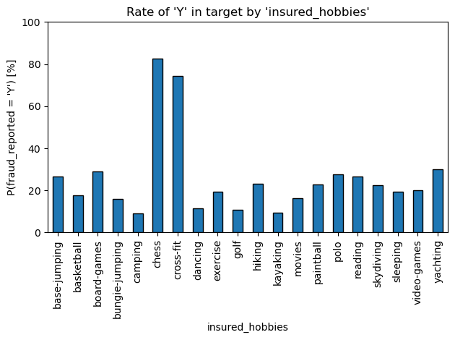
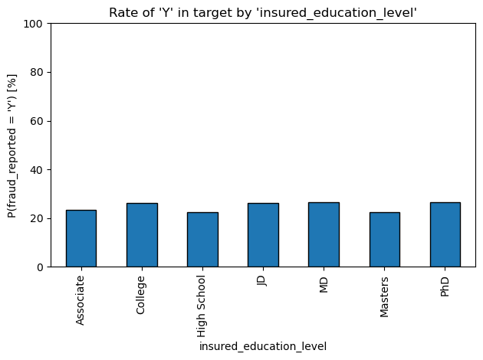
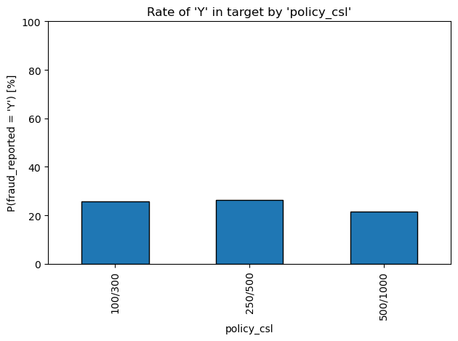
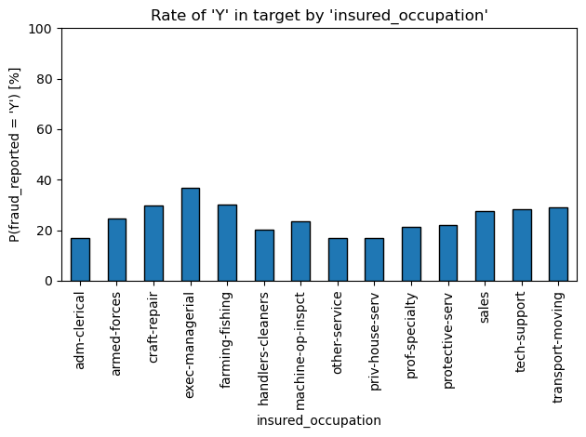
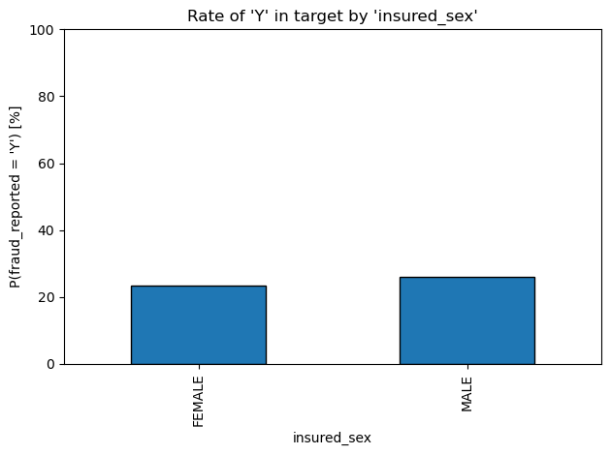
Bivariate Analysis (Categorical Columns) Part 1

Slide 12
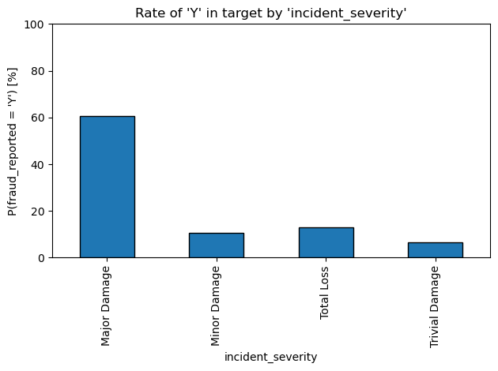
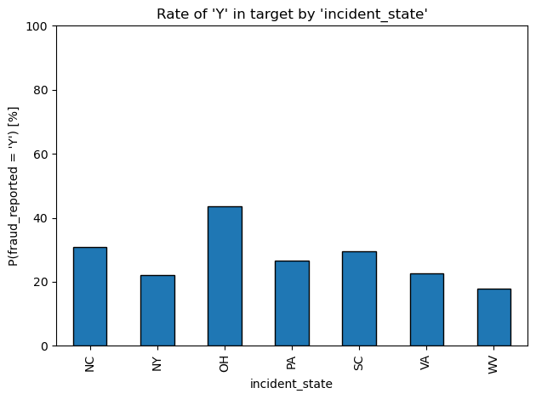
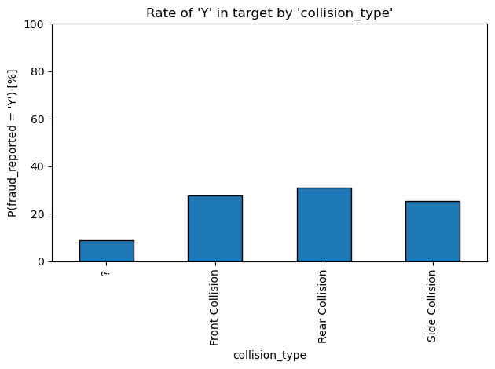
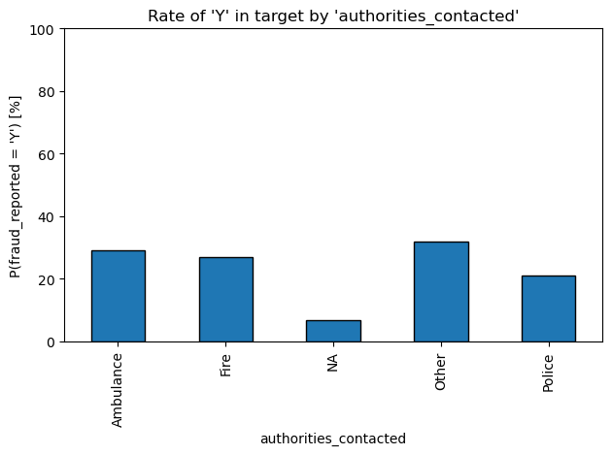
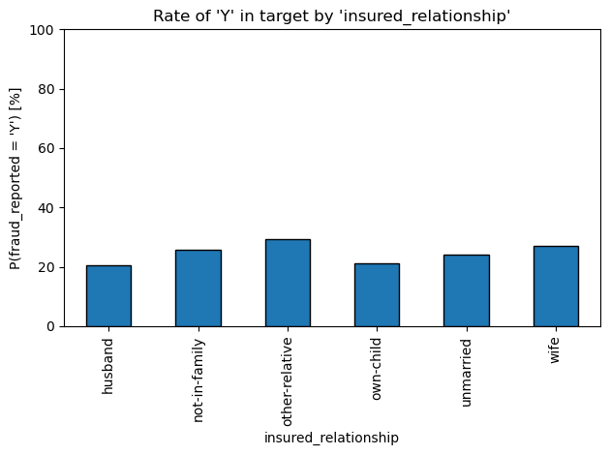
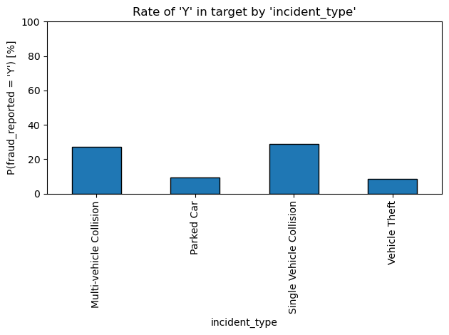
Bivariate Analysis (Categorical Columns) Part 2

Slide 13
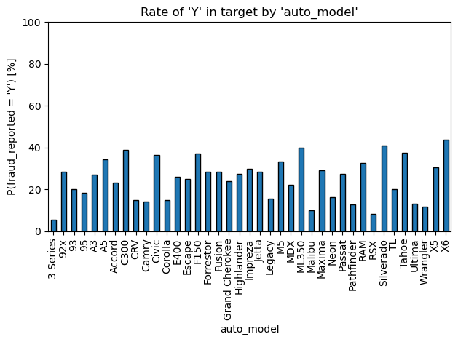
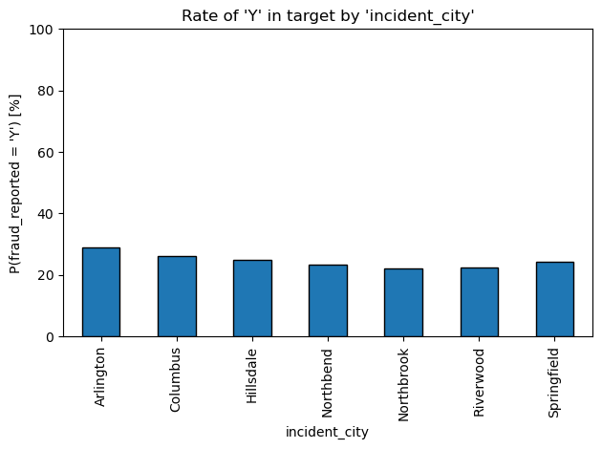
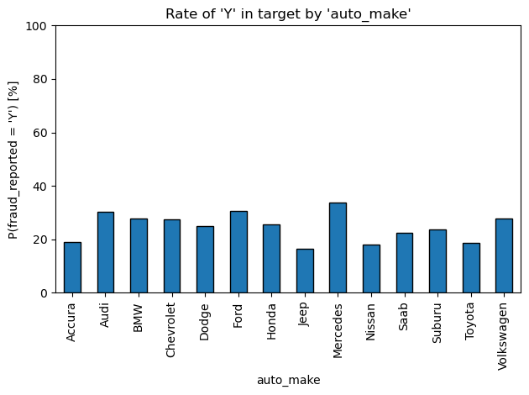
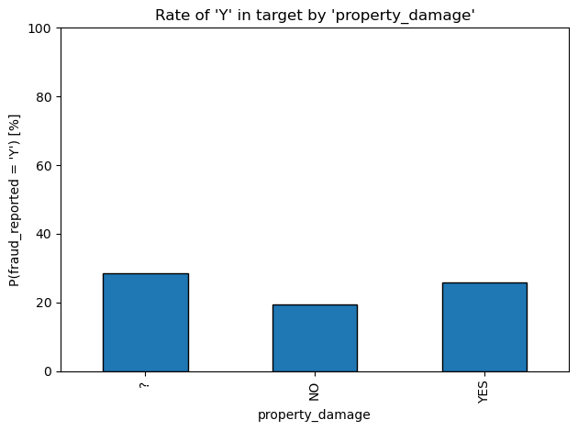
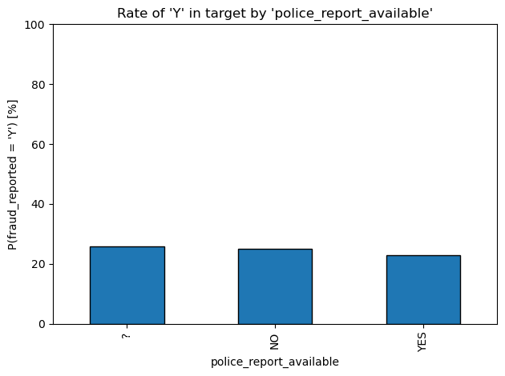
Bivariate Analysis (Categorical Columns) Part 3

Slide 14
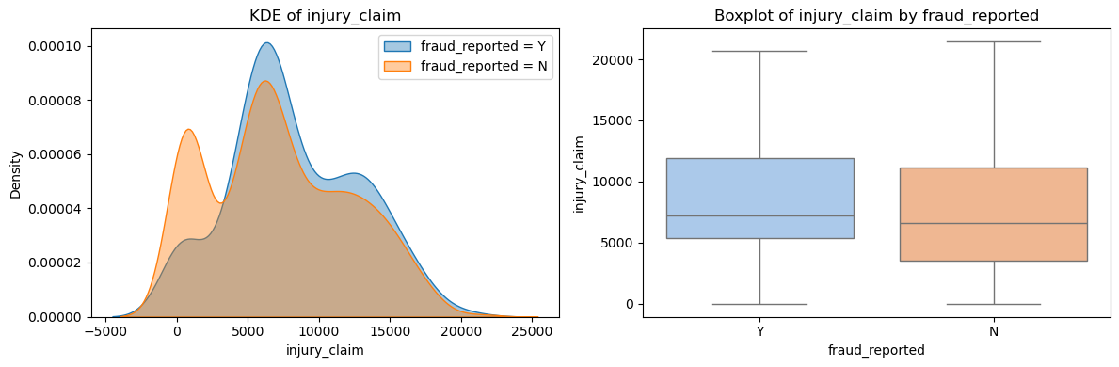
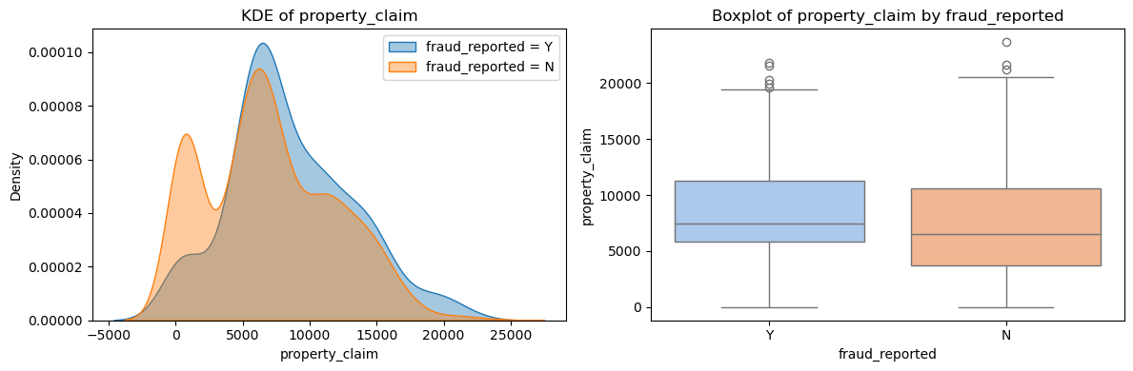
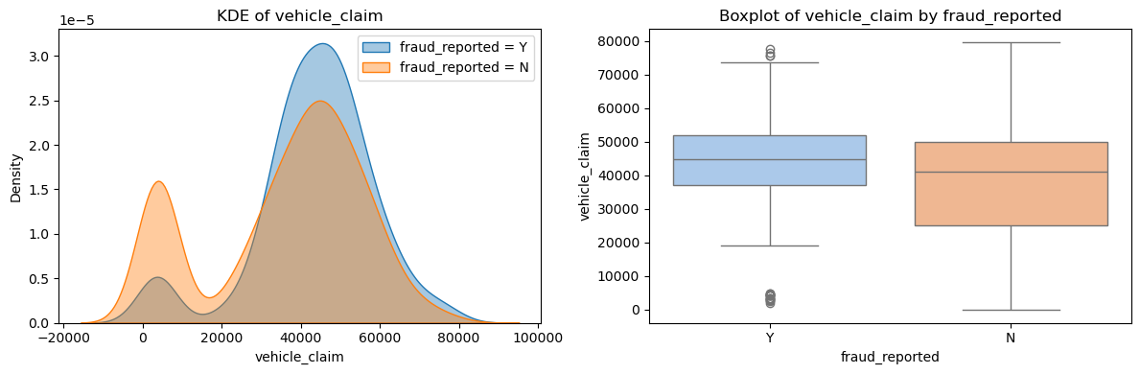
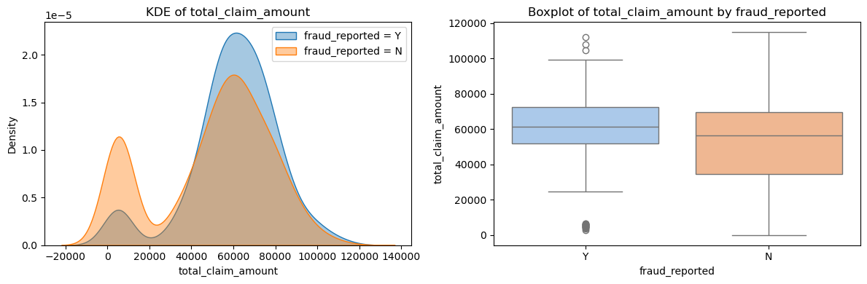
Bivariate Analysis (Numerical Columns) Part 1

Slide 15
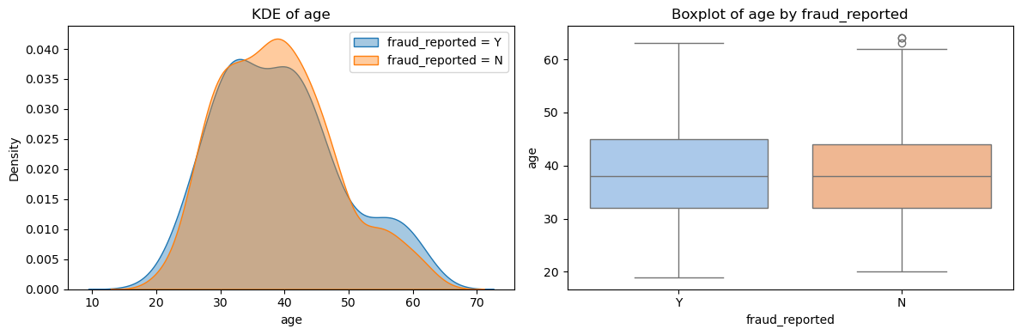
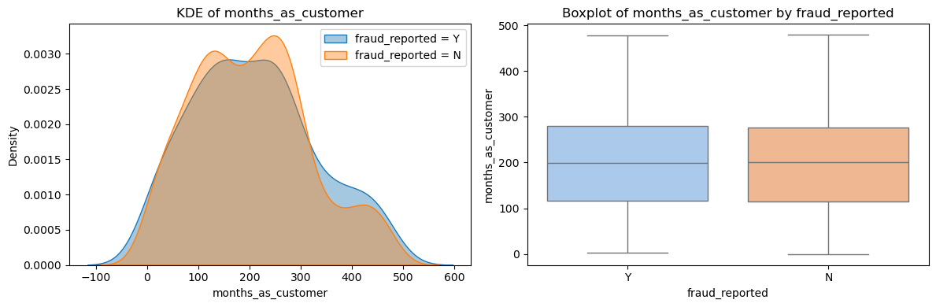
Bivariate Analysis (Numerical Columns) Part 2

Slide 16
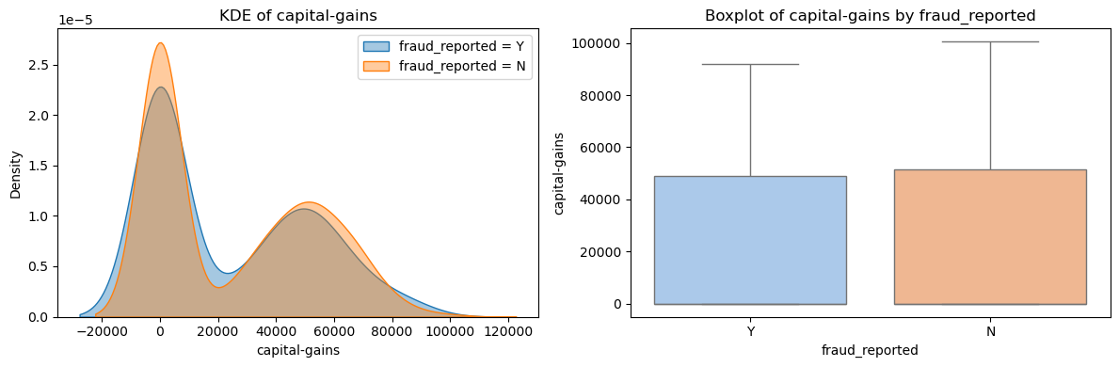
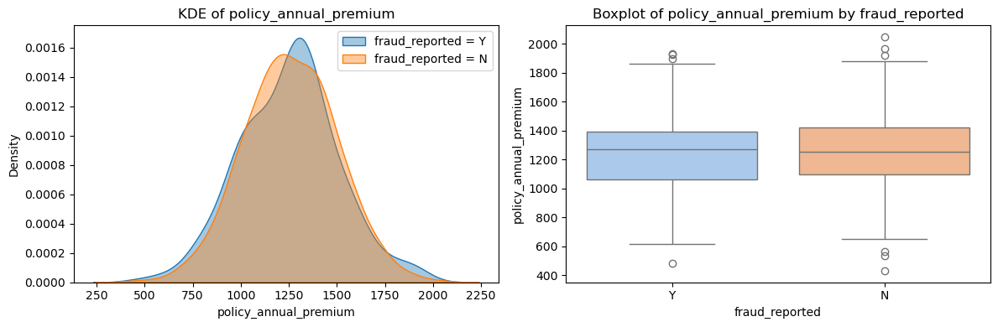
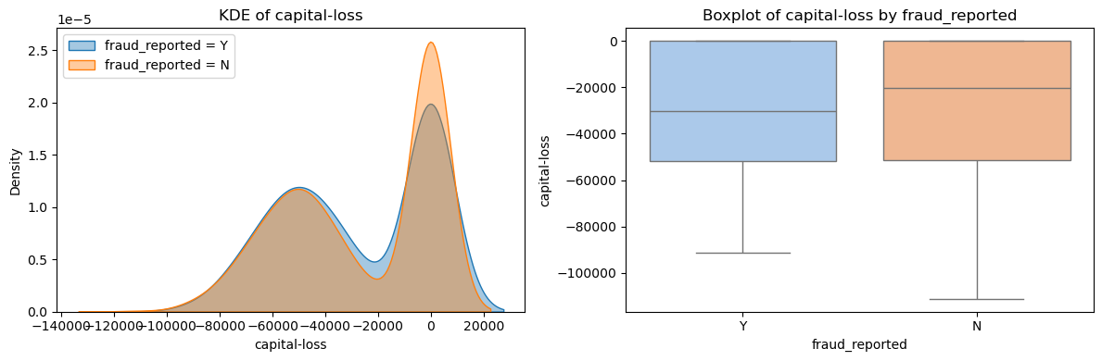
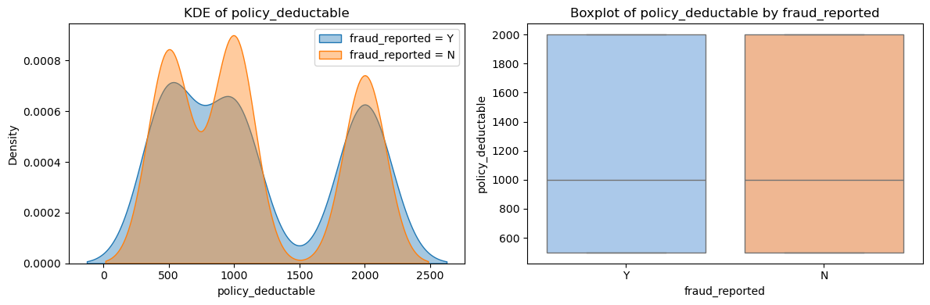
Bivariate Analysis (Numerical Columns) Part 3

Slide 17
Uninformative Columns
Based on bivariate analysis, features with little or no predictive power were identified
Categorical Features identified as uninformative:
witnesses
bodily_injuries
police_report_available
Numerical Features identified as uninformative :
capital-gains
capital-loss
incident_hour_of_the_day

Slide 18
Feature Engineering

Slide 19
Resampling
The dataset had significant class imbalance (few fraud cases compared to legitimate claims).
Class imbalance can cause the model to ignore the minority (fraud) class.
Resampling was used to balance classes (equal number of 'Y' and 'N'), ensuring fair model training and improved fraud detection.

Slide 20
Feature Creation
New features were created from existing columns to capture hidden patterns:
Temporal features (month, year, day type from dates) for seasonality & trends.
Claim ratios to highlight abnormal claim distributions.
Vehicle age & interactions to capture risk profiles.
These features help the model detect subtle cues related to fraud.

Slide 21
Handling Redundant Columns
Removed columns that duplicated information now captured by engineered features:
Dropped raw date columns, original claim components, and vehicle year.
This step will reduce multicollinearity, simplify the dataset, and focuses learning on relevant inputs.

Slide 22
Handling Categorical Columns
Rare categories in features like occupation, hobbies, state, make, and model were grouped into 'Other’.
This step prevents overfitting, improves generalization, and ensures each category has sufficient data for learning meaningful patterns.
All categorical variables were converted to dummy (one-hot) variables.
Ensured consistent encoding across training and validation sets.
Required for most machine learning models to interpret categorical data numerically.

Slide 23
Model Building

Slide 24
Model Building Overview
Developed and compared two machine learning models for fraud detection:
Logistic Regression: Interpretable, strong baseline.
Random Forest: Captures non-linearities, robust to overfitting.
Data split into training, validation, and test sets for unbiased evaluation.
Fair comparison using the same features and optimal cutoff selection.

Slide 25
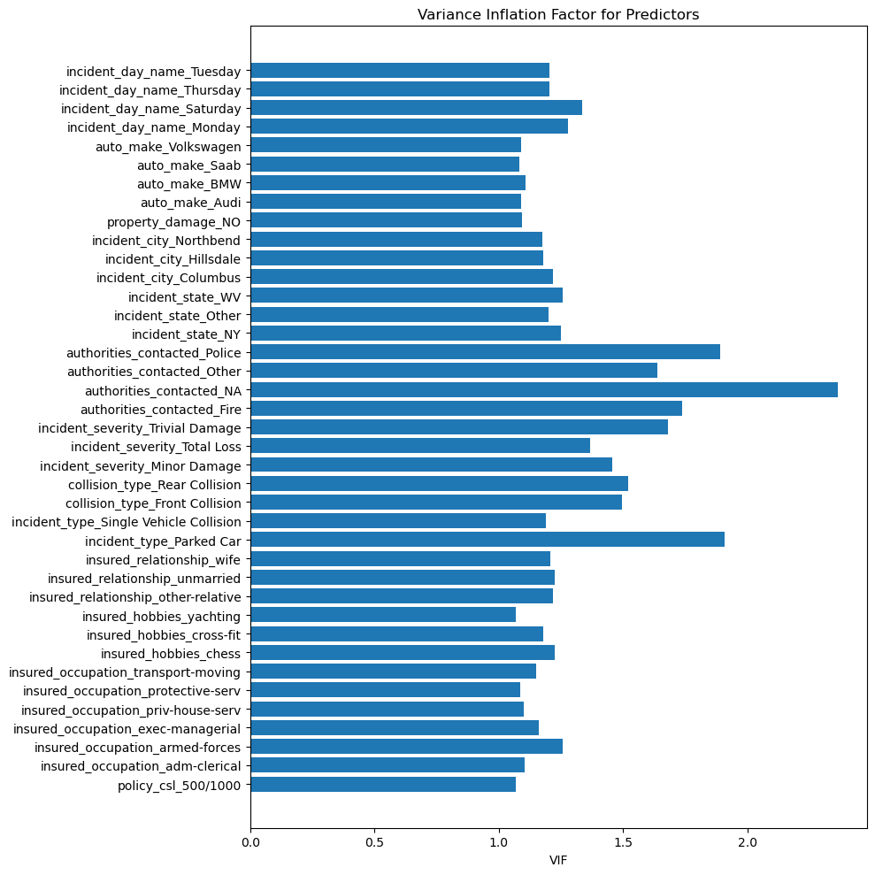
Logistic Regression - VIF

Slide 26
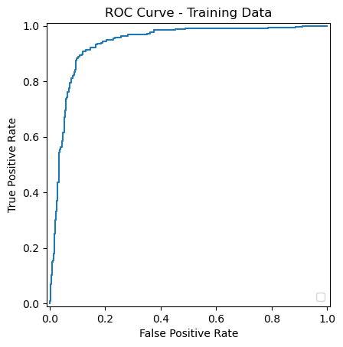
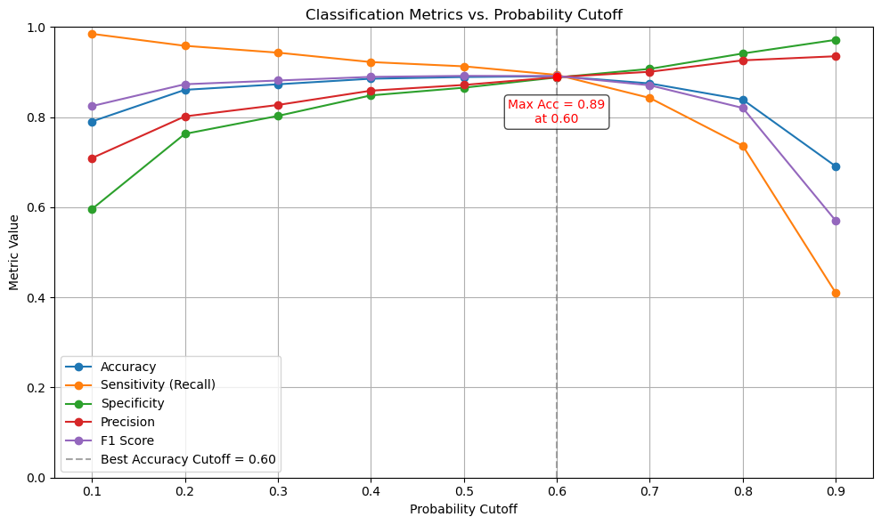
Logistic Regression – Optimal Cutoff
Based on ROC curve and Classification metrices, optimal cutoff identified is 0.6

Slide 27
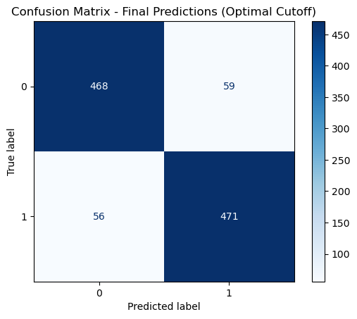
Logistic Regression Confusion Metrics (Train data)

Slide 28
Logistic Regression Training data Key Metrics
Accuracy: 0.8909
Sensitivity: 0.8937
Specificity: 0.8880
Precision: 0.8887
Recall: 0.8937
F1 Score: 0.8912

Slide 29
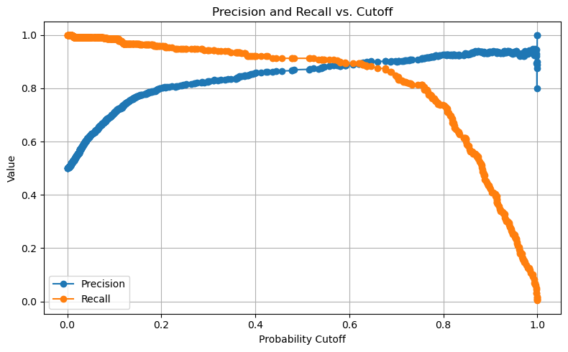
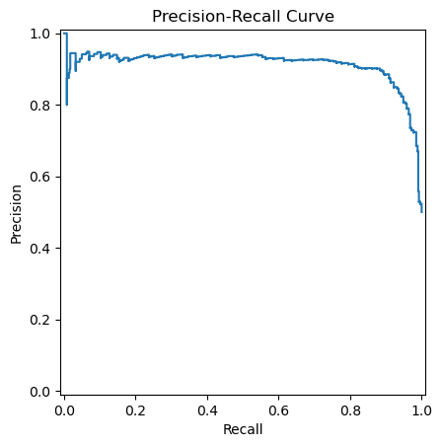
Logistic Regression Visualizations

Slide 30
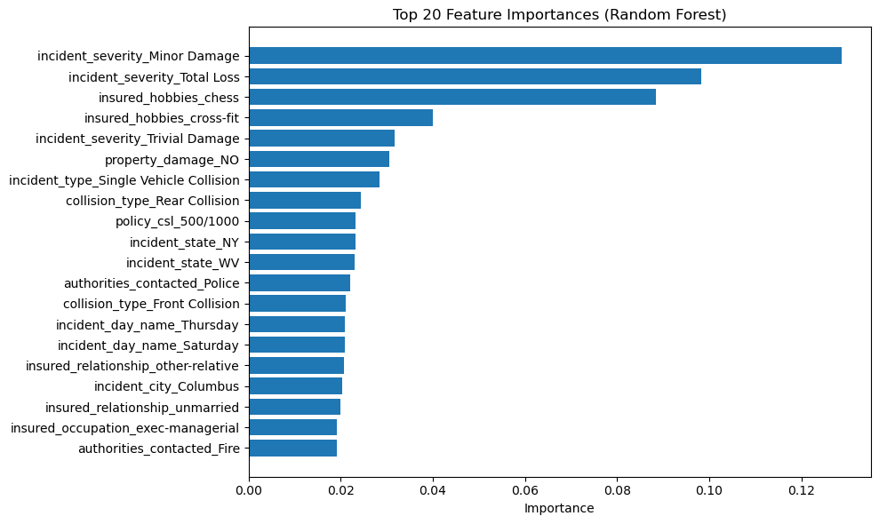
Random Forest – Feature Importance

Slide 31
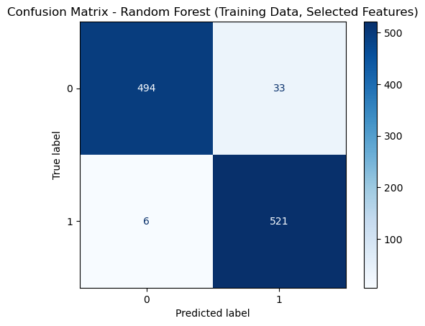
Random Forest Confusion Metrics (Train Data)

Slide 32
Random Forest Training Data Key Metrices
Accuracy: 0.9630
Sensitivity : 0.9886
Specificity: 0.9374
Precision: 0.9404
Recall: 0.9886
F1 Score: 0.9639
Mean CV score: 0.8975

Slide 33
Random Forest Hyperparameter Tuning Best Parameters
max_features=sqrt
min_samples_leaf=1
min_samples_split=2
random_state=42
n_estimators=100
max_depth=None

Slide 34
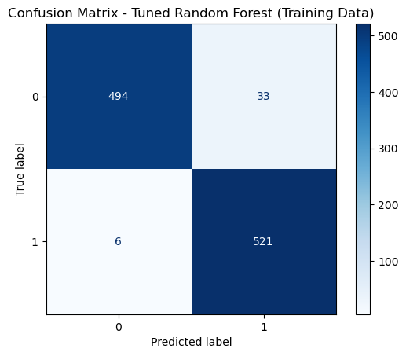
Tuned Random Forest Model Confusion Metrics (Train Data)

Slide 35
Tuned Random Forest Key Metrics (Training Data)
Accuracy: 0.9630
Sensitivity: 0.9886
Specificity: 0.9374
Precision: 0.9404
Recall: 0.9886
F1 Score: 0.9639

Slide 36
Model Evaluation

Slide 37
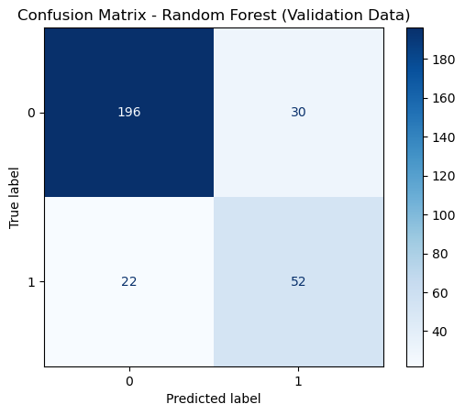
Logistic Regression Confusion Metrics (Test Data)

Slide 38
Logistic Regression Test Data Key Metrices
Accuracy: 0.8300
Sensitivity: 0.7027
Specificity: 0.8717
Precision: 0.6420
Recall: 0.7027
F1 Score: 0.6710

Slide 39
Random Forest Confusion Metrics (Test Data)

Slide 40
Random Forest Test Data Key Metrices
Accuracy: 0.8267
Sensitivity: 0.7027
Specificity: 0.8673
Precision: 0.6341
Recall: 0.7027
F1 Score: 0.6667

Slide 41
Evaluation and Conclusion

Slide 42
Model Comparison
Both Logistic Regression and Random Forest models were developed and evaluated to classify insurance claims as fraudulent or legitimate. The models were rigorously tested using appropriate feature engineering, resampling, and careful selection of predictors to optimize predictive performance and minimize overfitting.
Logistic Regression achieved an accuracy of 0.83, sensitivity (recall) of 0.70, and specificity of 0.87. The precision was 0.64 and F1-score 0.67. This model is interpretable and performs well in distinguishing fraudulent claims, with a good balance between precision and recall.
Random Forest achieved an accuracy of 0.81, sensitivity of 0.61, specificity of 0.88, precision of 0.63, and F1-score 0.61. While it demonstrated high performance on training data and offered robust handling of complex feature interactions, it showed a slight reduction in sensitivity compared to Logistic Regression on unseen data, suggesting a tendency toward conservatism in predicting frauds.

Slide 43
Key Findings
Feature engineering—including derived ratios, vehicle age, and interaction features—helped capture complex patterns relevant to fraud detection.
Combining rare categorical levels and removing highly unique identifiers improved model generalizability and prevented overfitting.
The optimal cutoff for classifying claims was determined through ROC and precision-recall analysis, ensuring a balanced tradeoff between catching fraud and minimizing false alarms.

Slide 44
Conclusion
The Logistic Regression model slightly outperformed the Random Forest in terms of recall and F1-score on validation data, making it a suitable choice for scenarios where missing fraudulent claims is especially costly.
However, both models demonstrated strong and reliable performance and can be used together in an ensemble or layered approach for real-world deployment.
Regular monitoring and retraining are recommended as fraud patterns may evolve over time.

Slide 45
Recommendations
Deploy
Deploy the Logistic Regression model for initial claim screening, with Random Forest as a secondary check for ambiguous cases.
Continue
Continue to enhance data quality and feature engineering and consider including additional external data sources if available.
Re-evaluate
Periodically re-evaluate model thresholds to align with business objectives and changing fraud trends.

Slide 46
Thank You

